Slide 1
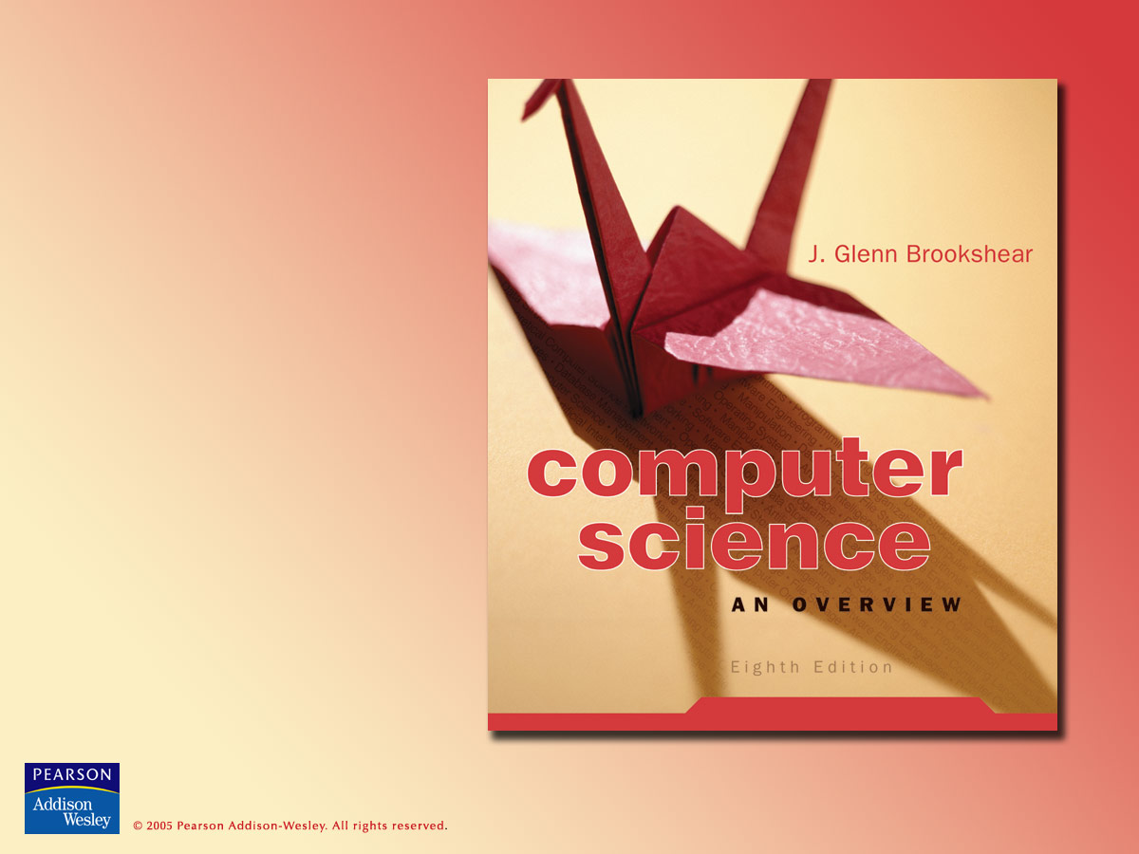
Chapter 6
Programming Languages

Slide 2

Chapter 6: Programming Languages
6.1 Historical Perspective
6.2 Traditional Programming Concepts
6.3 Procedural Units
6.4 Language Implementation
6.5 Object Oriented Programming
6.6 Programming Concurrent Activities
6.7 Declarative Programming

Slide 3
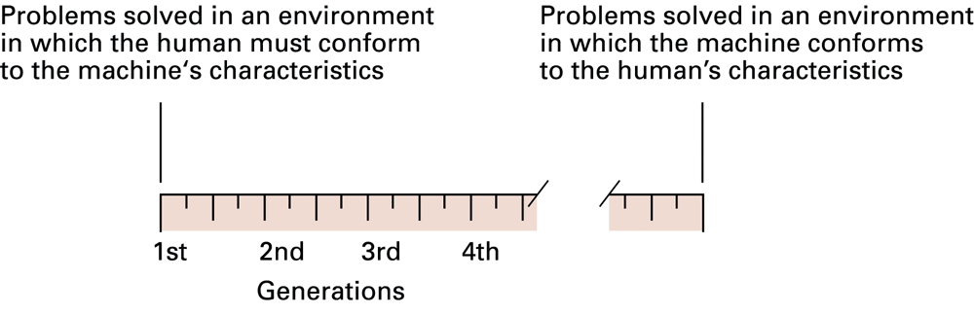
Figure 6.1 Generations of programming languages

Slide 4
Second-generation:
Assembly language
A mnemonic system for representing programs
  Mnemonic names for op-codes
  Names for all registers
  Identifiers = descriptive names for memory locations, chosen by the programmer

Slide 5
Assembly language characteristics
One-to-one correspondence between machine instructions and assembly instructions
  Programmer must think like the machine
Inherently machine-dependent
Converted to machine language by a program called an assembler

Slide 6
Assembly language example
Machine language
156C
166D
5056
30CE
C000
Assembly language
LD R5, Price
LD R6, ShippingCharge
ADDI R0, R5 R6
ST R0, TotalCost
HLT

Slide 7
Third generation language
Uses high-level primitives
  Similar to our pseudocode in Chapter 5
Machine independent (mostly)
Examples: FORTRAN, COBOL
Each primitive corresponds to a short sequence of machine language instructions
Converted to machine language by a program called a compiler

Slide 8
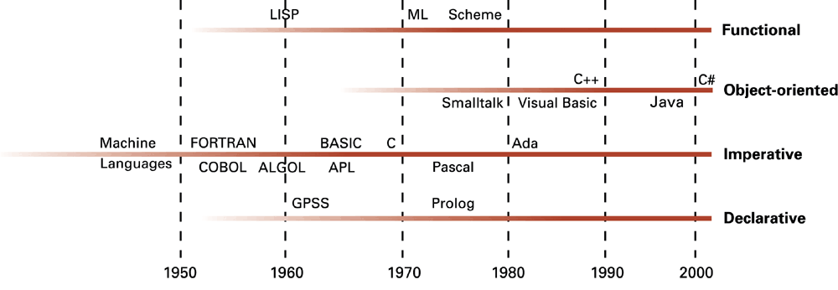
Figure 6.2 The evolution of programming paradigms

Slide 9
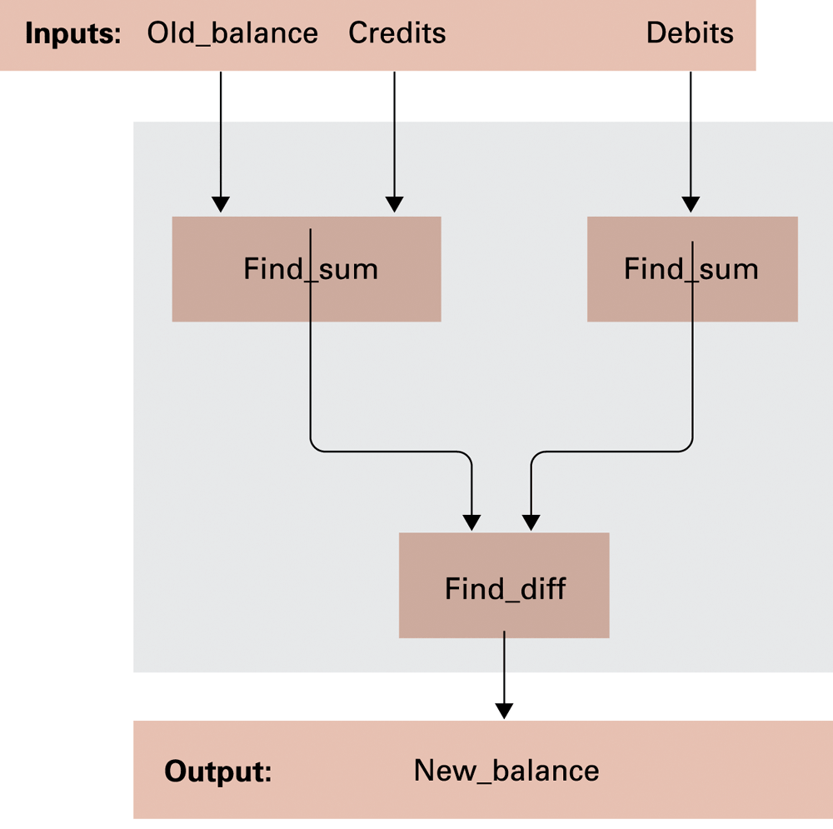
Figure 6.3 A function for checkbook balancing constructed from simpler functions

Slide 10
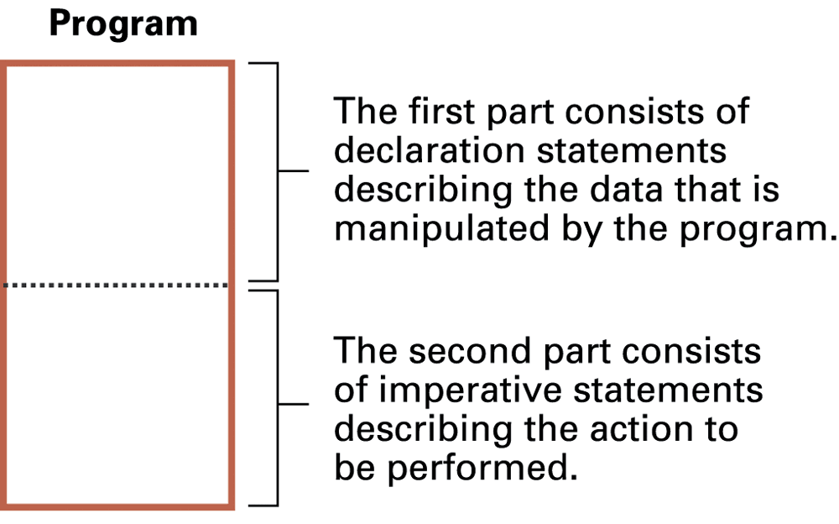
Figure 6.4 The composition of a typical imperative program or program unit

Slide 11
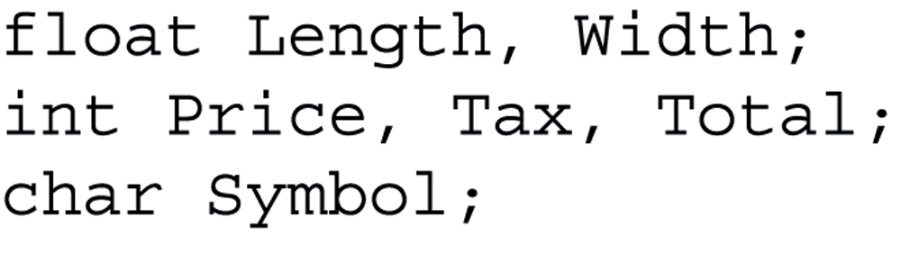
Figure 6.5 Variable declarations in C, C++, C#, and Java

Slide 12
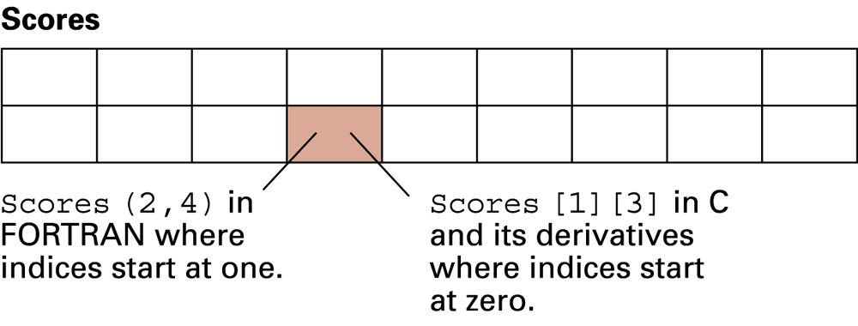
Figure 6.6 A two-dimensional array with two rows and nine columns

Slide 13
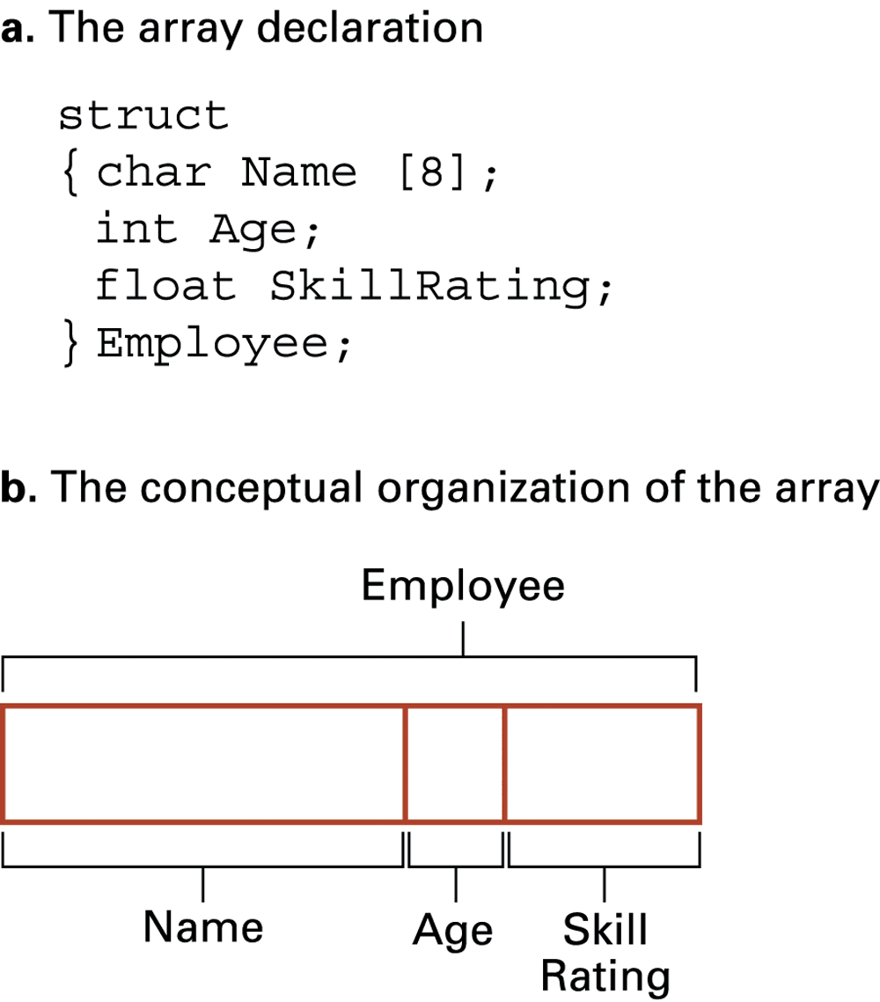
Figure 6.7 Declaration of heterogeneous array

Slide 14
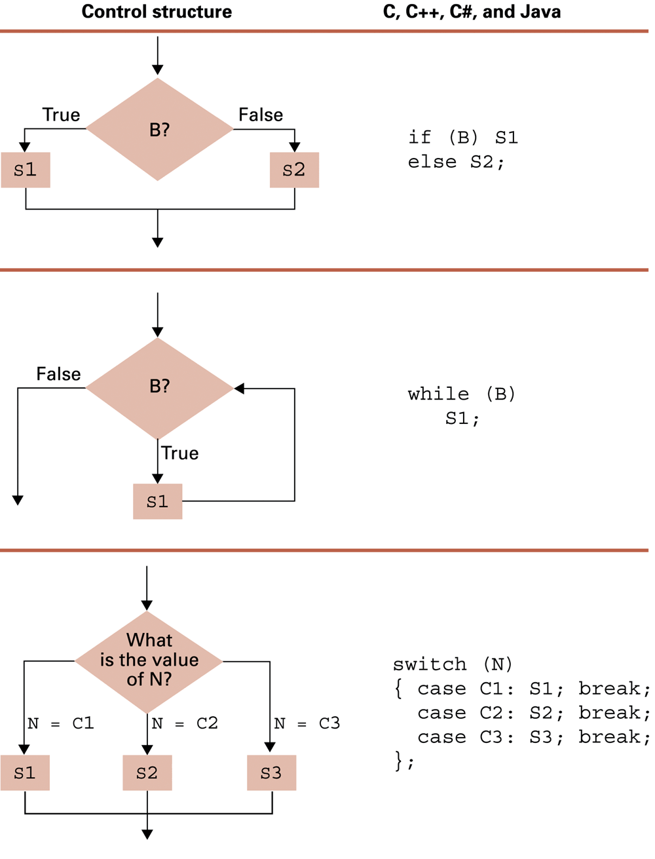
Figure 6.8 Control structures and their representations in C, C++, C#, and Java

Slide 15
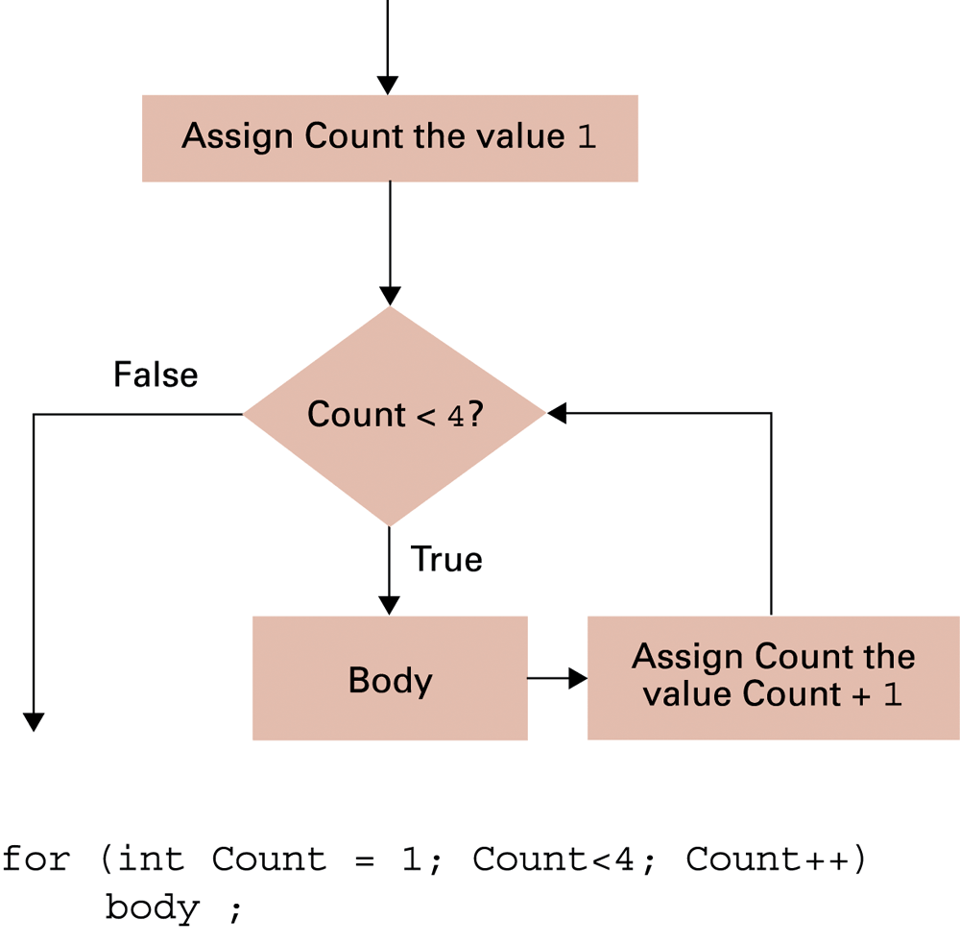
Figure 6.9 The for loop structure and its representation in C++, C#, and Java

Slide 16
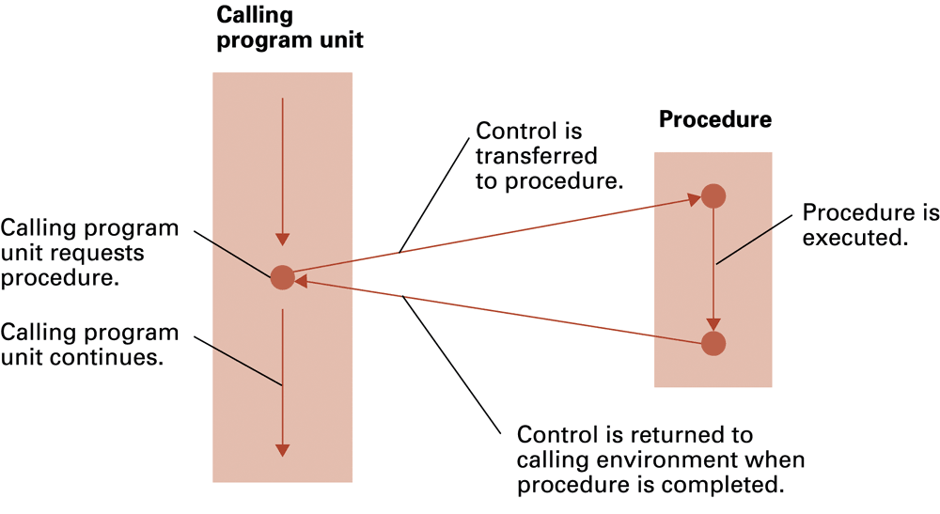
Figure 6.10 The flow of control involving a procedure

Slide 17
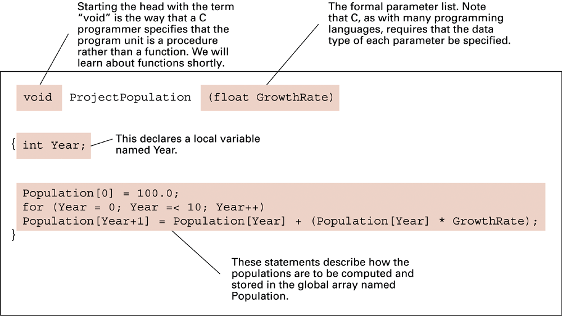
Figure 6.11 The procedure ProjectPopulation written in the programming language C

Slide 18
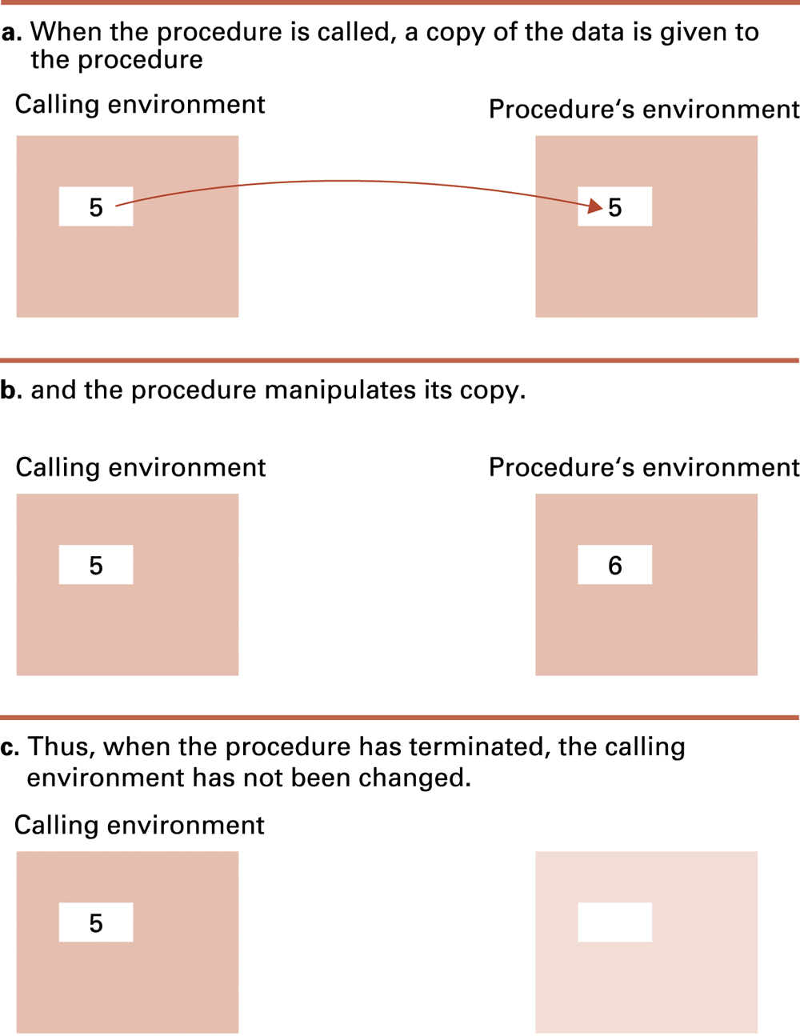
Figure 6.12 Executing the procedure Demo and passing parameters by value

Slide 19
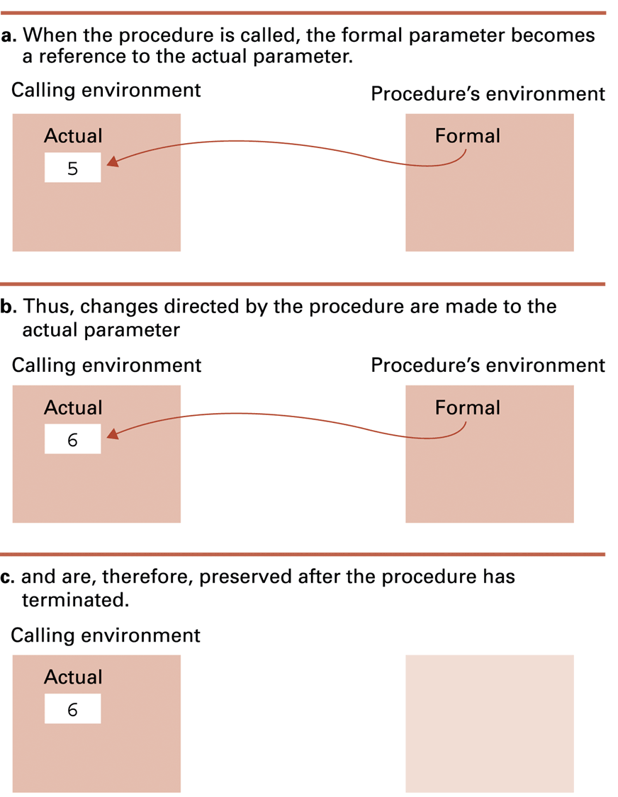
Figure 6.13 Executing the procedure Demo and passing parameters by reference

Slide 20
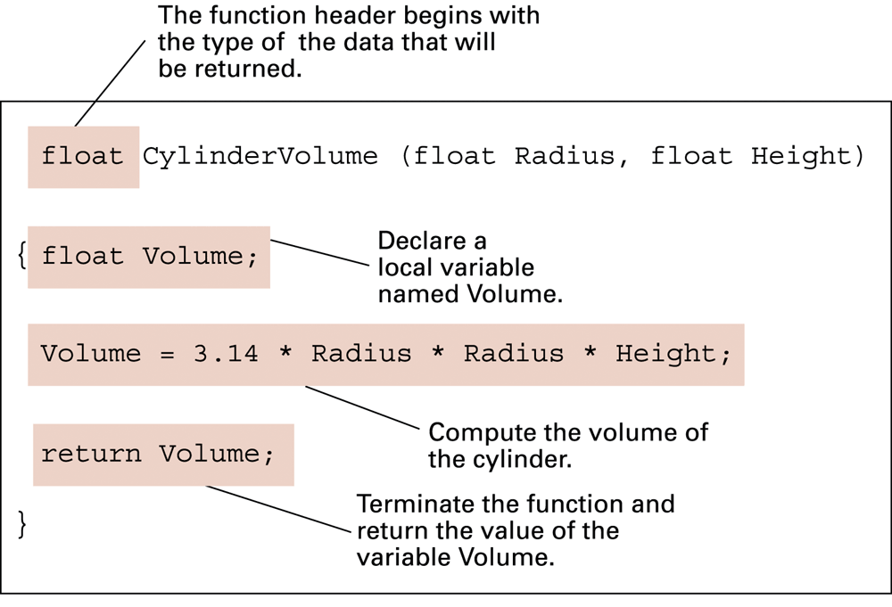
Figure 6.14 The function CylinderVolume written in the programming language C

Slide 21

Figure 6.15 The translation process

Slide 22
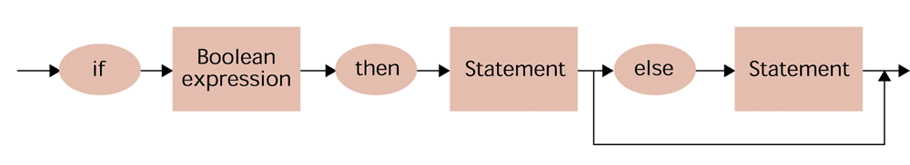
Figure 6.16 A syntax diagram of our if-then-else pseudocode statement

Slide 23
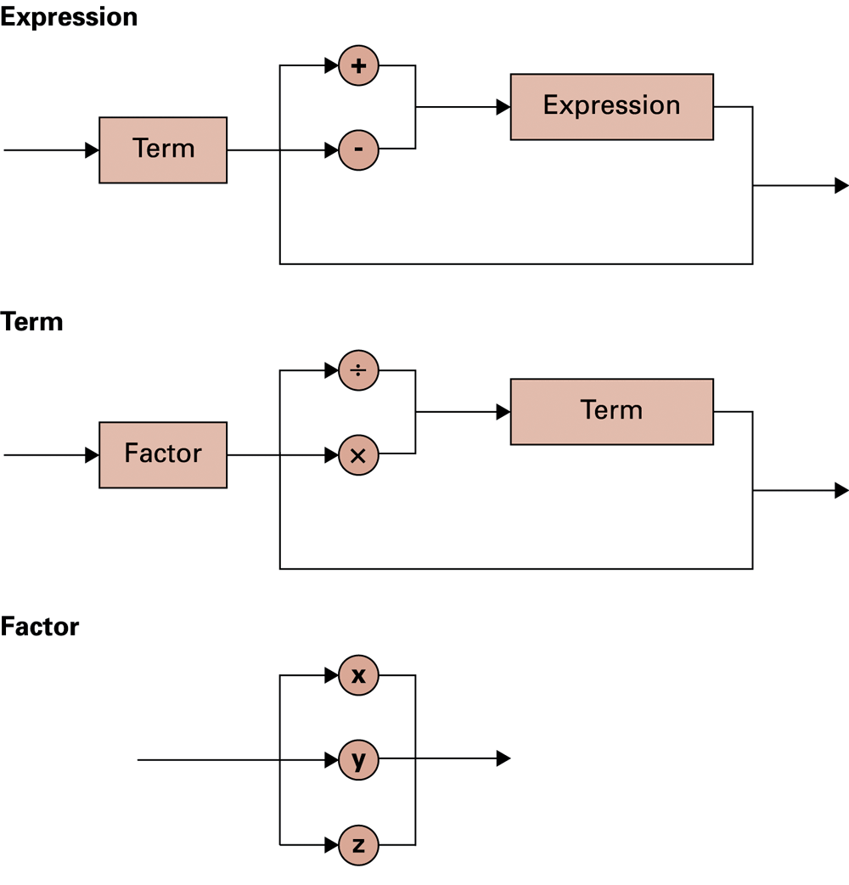
Figure 6.17 Syntax diagrams describing the structure of a simple algebraic expression

Slide 24
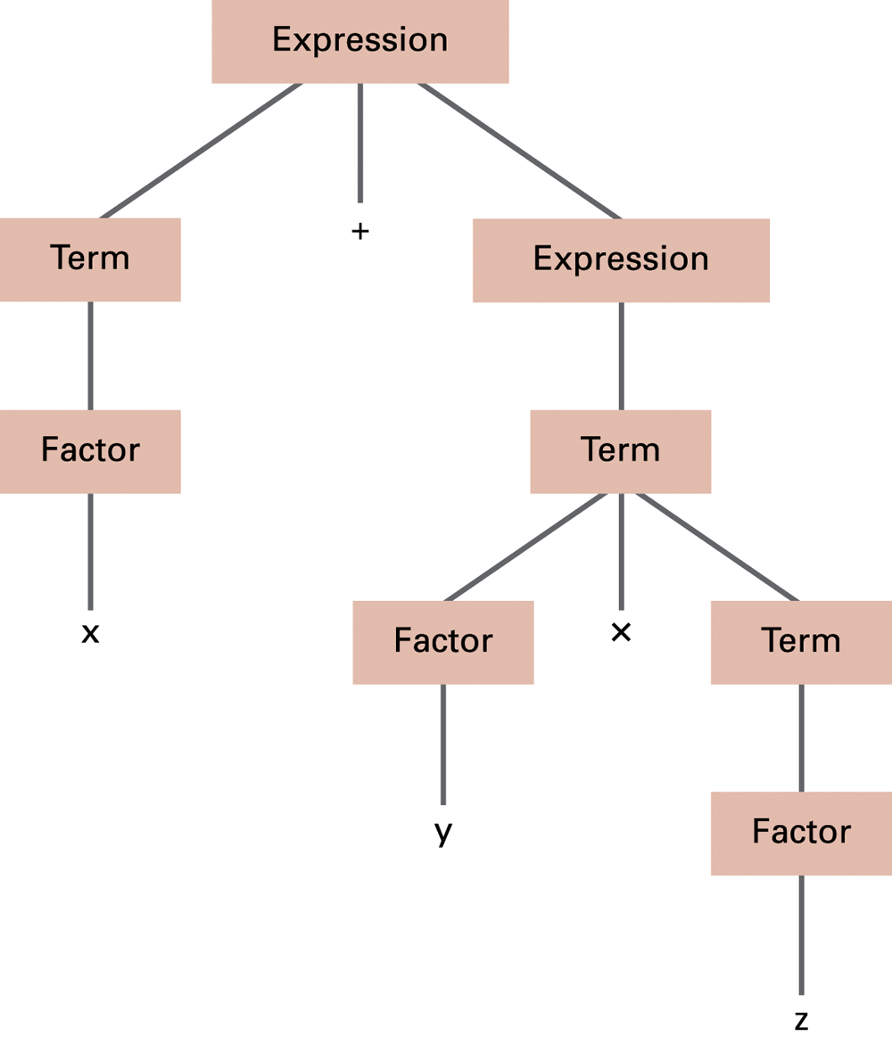
Figure 6.18 The parse tree for the string x + y x z based on the syntax diagrams in Figure 6.17

Slide 25
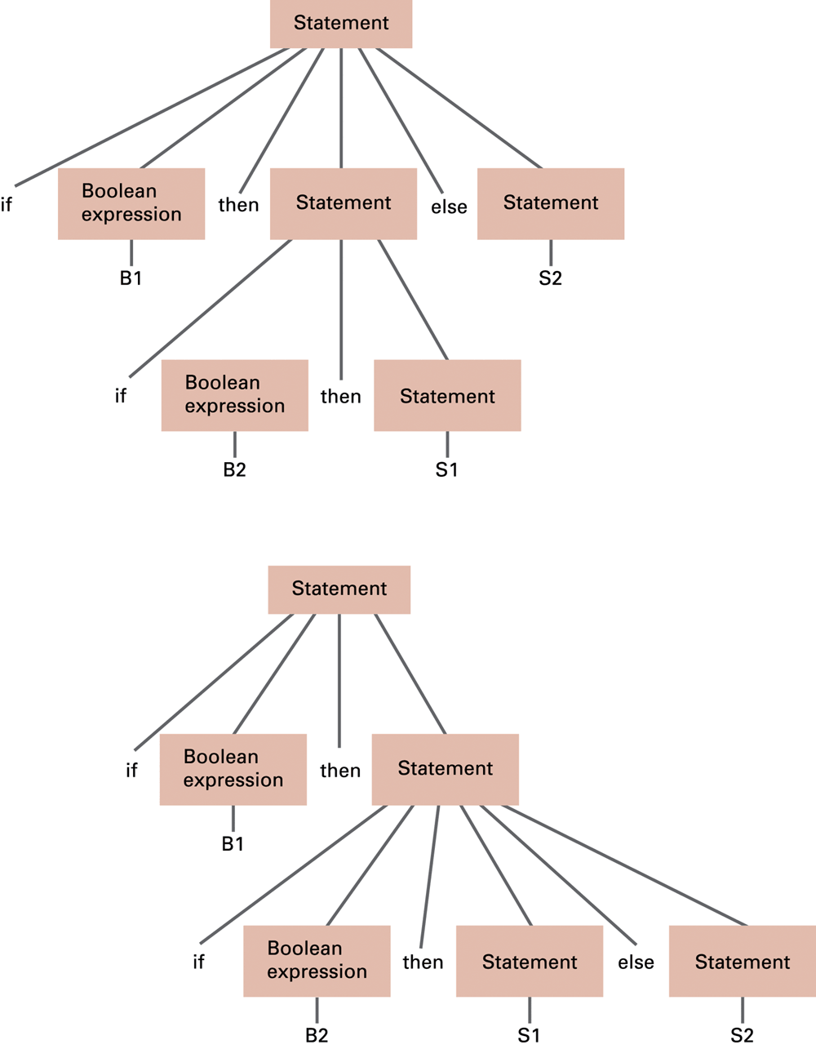
Figure 6.19
Two distinct parse trees for the statement if B1 then if B2 then S1 else S2

Slide 26
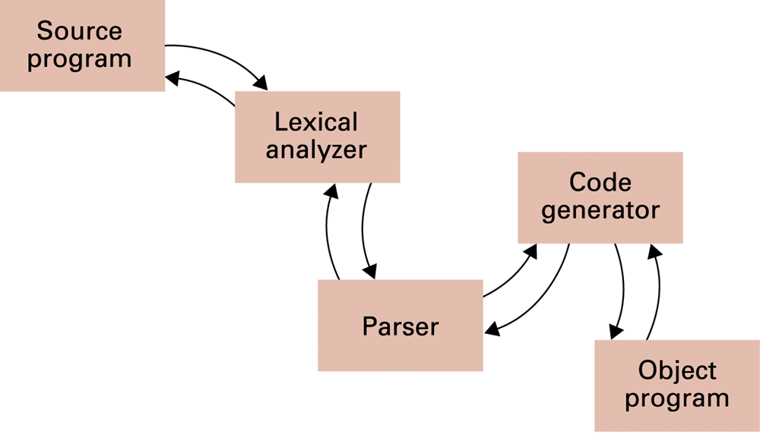
Figure 6.20 An object-oriented approach to the translation process

Slide 27
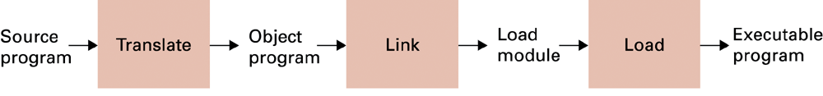
Figure 6.21 The complete program preparation process

Slide 28
Objects and Classes
Object = active program unit containing both data and procedures
Class = a template for all objects of the same type
An Object is often called an instance of the class.

Slide 29
Components of an object
Instance variable = variable within an object
Method = function or procedure within an object
  Can manipulate the object’s instance variables
Constructor = special method to initialize a new object instance

Slide 30
Encapsulation
Encapsulation = a way of restricting access to the internal components of an object
  Private
  Public

Slide 31
Additional object-oriented concepts
Inheritance: allows new classes to be defined in terms of previously defined classes
Polymorphism: allows method calls to be interpreted by the object that receives the call

Slide 32
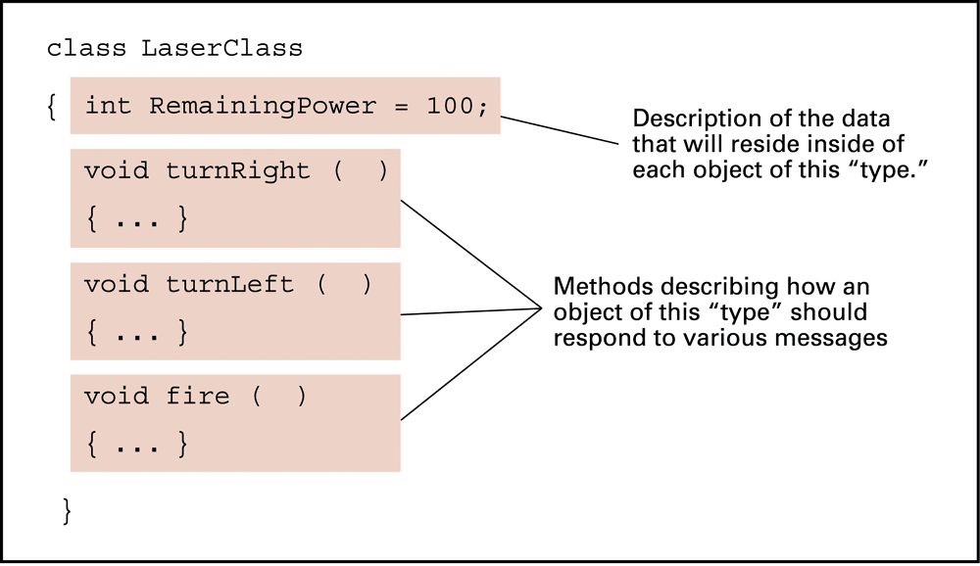
Figure 6.22 The structure of a class describing a laser weapon in a computer game

Slide 33
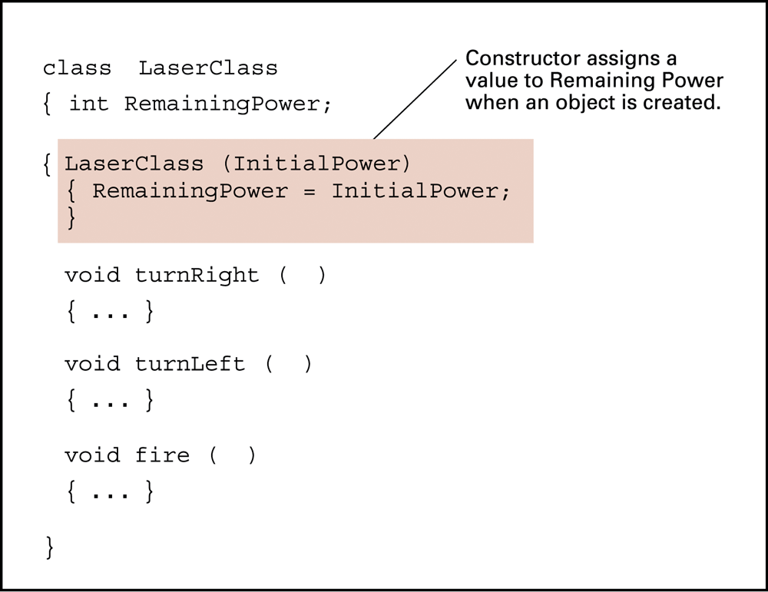
Figure 6.23 A class with a constructor

Slide 34
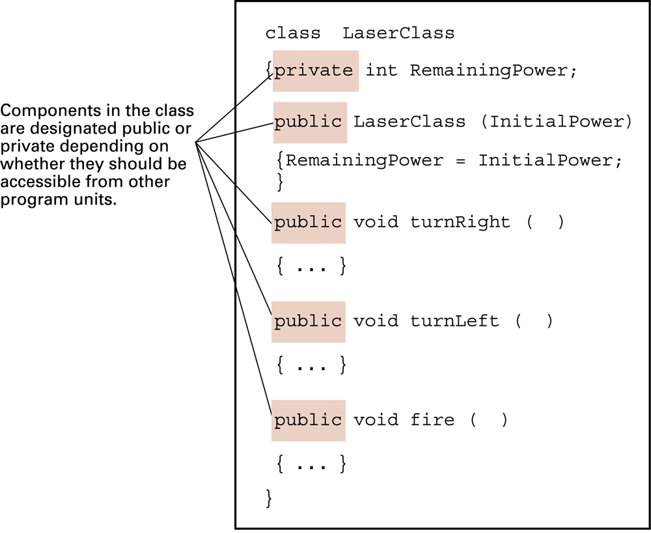
Figure 6.24 Our LaserClass definition using encapsulation as it would appear in a Java or C# program

Slide 35
Programming concurrent activities
Parallel or concurrent processing = simultaneous execution of multiple processes
  True concurrent processing requires multiple CPUs
  Can be simulated using time-sharing with a single CPU

Slide 36
Interaction between processes
Mutual exclusion = a method for ensuring that data can be accessed by only one process at a time
Monitor = a data item augmented with the ability to control access to itself

Slide 37
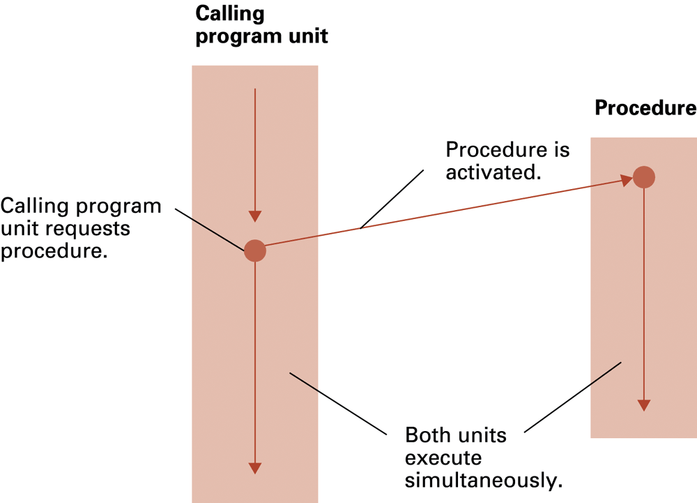
Figure 6.25 Spawning processes

Slide 38
Declarative programming
Resolution = combining two or more statements to produce a new, logically equivalent statement
  Example: (P OR Q) AND (R OR ¬Q)
  resolves to (P OR R)
  Resolvent = a new statement deduced by resolution
  Clause form = statement whose elementary components are connected by the Boolean operation OR
Unification = assigning a value to a variable in a statement

Slide 39
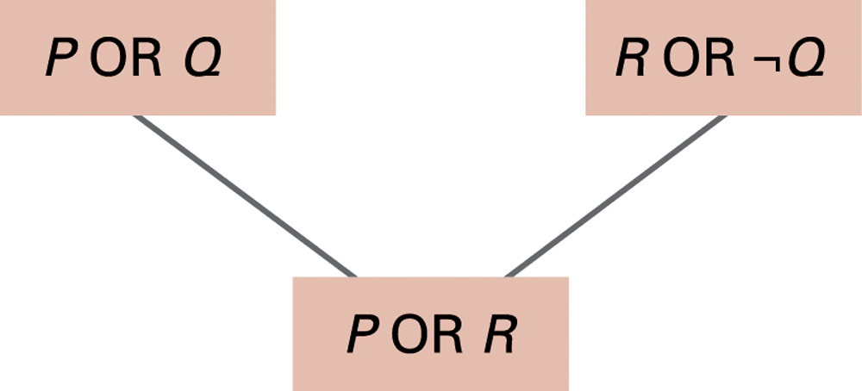
Figure 6.26 Resolving the statements (P OR Q) and (R OR ¬Q) to produce (P OR R)

Slide 40
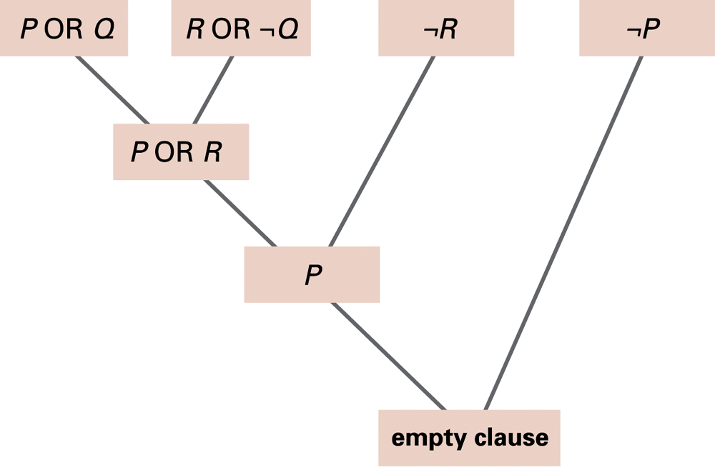
Figure 6.27 Resolving the statements (P OR Q), (R OR ¬Q), ¬R, and ¬P

Slide 41
Prolog
Fact = predicateName(arguments).
  Example: parent(bill, mary).
Rule = conclusion :- premise.
  :- means “if”
  Example: wise(X) :- old(X).
  Example: faster(X,Z) :- faster(X,Y), faster(Y,Z).
All statements must be fact or rules.

